Slide 1
Hydraulic Diagram and Calculations

Slide 2

1. Label the Diagram

Slide 3
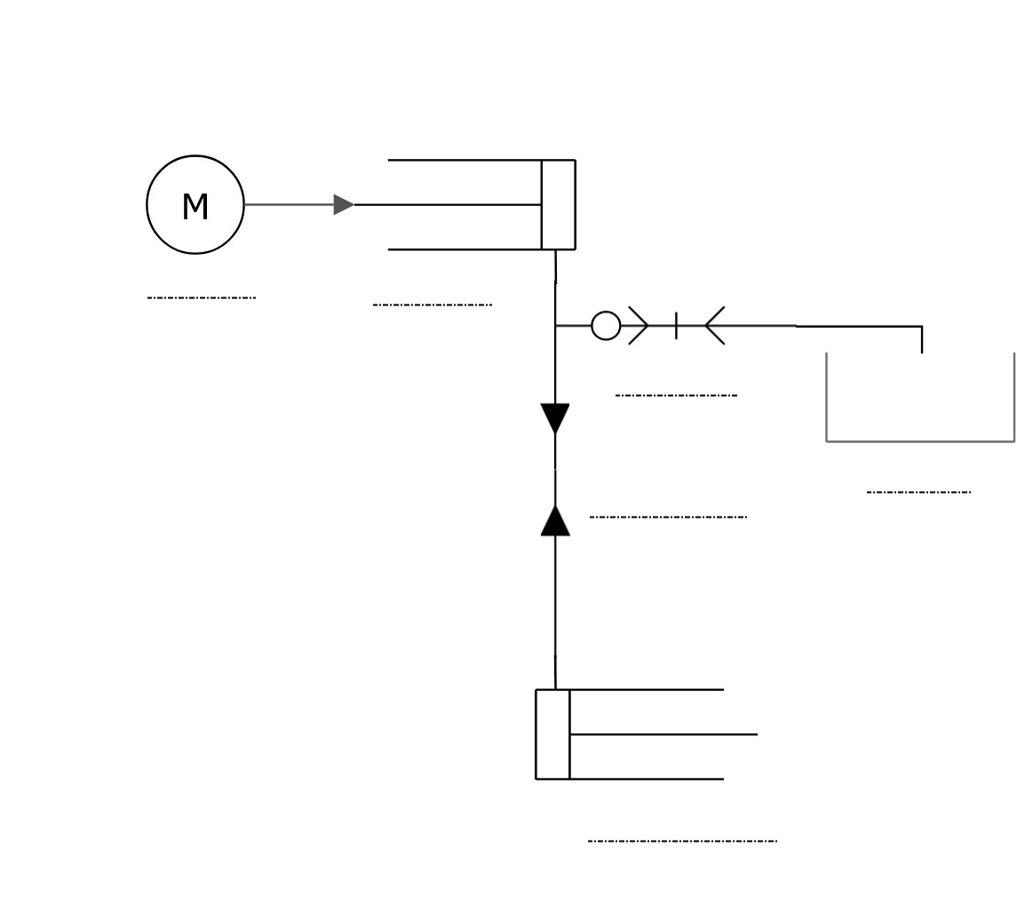

Slide 4
2. Draw the Diagram

Slide 5
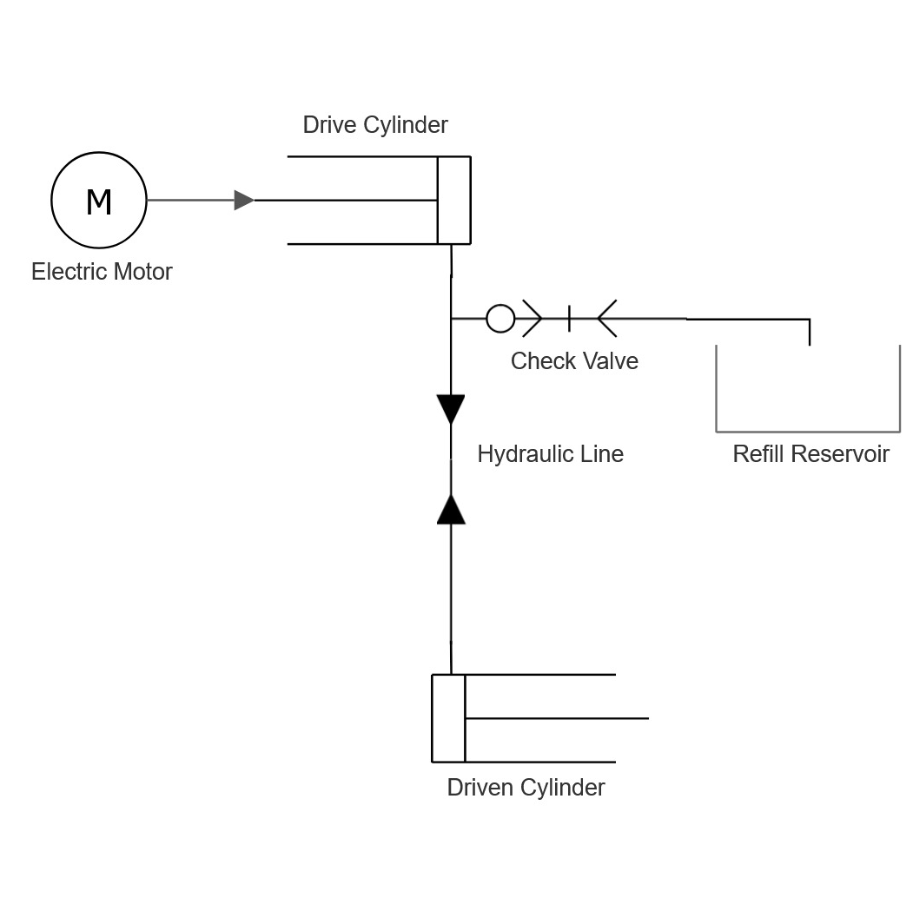

Slide 6

3. Calculations

Slide 7




1 Convert syringe volumes to dimensions

Slide 8







1 Convert syringe volumes to dimensions

Slide 9


2 The linear motor pushes with F = 70 N. The pressure generated in the master syringe is:

Slide 10



3 Force on slave cylinder

Slide 11




4 Velocity of slave cylinder

Slide 12



4 Velocity of slave cylinder

Slide 13




5 Flow rate in hydraulic line

Slide 14







6 Hydraulic line velocity

Slide 15









7 Pressure drop in pipe

Slide 16
Thank you

